Slide 1

Presented by,
Sruthi Dev Thomas
Roll No:53
MCA LE
Guide-in-Charge:
Ms. Lisha Varghese

Slide 2
CONTENT
INTRODUCTION
WHAT IS SQLi Dumper???
FEATURES
IMPLEMENTATION
CONCLUSION
REFERENCES

Slide 3

INTRODUCTION
Penetration Test:
Penetration testing (also called pen testing) is the practice of testing a computer system, network or Web application to find vulnerabilities that an attacker could exploit.
Performed for: Websites/Servers/Networks
Performed by: Testers/ Network specialists/ Security Consultants.
Pen-testing can be classified into two kinds
Scanners and Attackers.

Slide 4
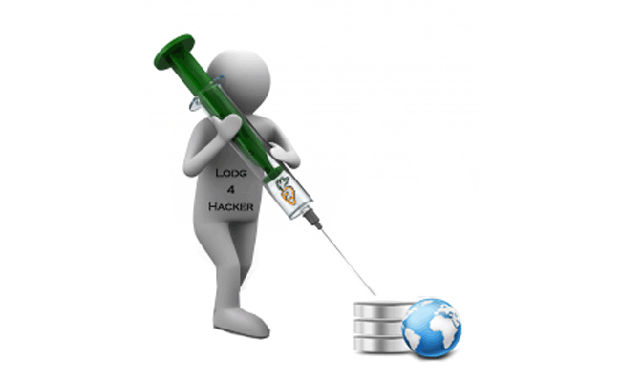
Pen-testing is exploiting the weak spots. So there are some software/tools that will show you the weak spots(Scanners), & some that show, and attack(Attackers).
SQL injection:
Kind of injection vulnerability in which the attacker tries to inject pieces of malicious data into the input fields of an application.
When processed by the application, causes that data to be executed as a piece of code by the back end SQL server. Thereby giving undesired results which the developer of the application did not anticipate.
Backend server can be any SQL server.

Slide 5
Dorks:
Dorks is mostly used over the Internet to Perform SQL Injection. Before Performing SQL Injection We Need to Find Vulnerable Website So, Dorks are the Small Codes that Spot Vulnerable sites Index in the Search Engine.

Slide 6
SQLi dumper
Excellent, advanced, automatic SQL injection tool for testing links that may contain SQL injection problems.
Can choose to create an individual .sql file for each table, or combine all selected tables into a single file.
Used in penetration testing to figure out and exploit SQL Injection vulnerabilities on a website.
Also take advantage of a vulnerable web application through some security loopholes.

Slide 7
Can use this tool to perform
Back end database fingerprinting
Retrieve DBMS login names and password hashes
Dump tables and columns
Fetch data from the database
Execute SQL statements against the server.
Requirements: .NET Framework 4.0 or greater.

Slide 8
The power of SQLi dumper
Success rate is more than 95% at injection vulnerable targets using sql dumper.
It has a User friendly GUI (Graphical User Interface).
Automated settings and detections makes it easy to use for everyone even amateur users.

Slide 9
Factors that make it better than the other exploitation tools.
Efficient.
Better Extraction of Tables.
Crash Protection.
Mailing List.
Brute Table & Column.

Slide 10
Supported Databases:
MySQL Time Based
MySQL Blind
MySQL Union Based
MySQL Error Based
MsSQL Blind
Oracle Union Based
Oracle Error Based

Slide 11
MsAccess Union Based
MsAccess Blind
MySQL 2000 and 2005 with both Error and Union Based.
Many other databases are supported by this tool.

Slide 12
FEATURES
Supports Multi. Online search engine (to find the targets);
Automated exploiting and analyzing from a URL list;
Automated search for data in a bulk URL list;
Automated analyzer for injections points using URL, POST, Cookies, UserLogin or UserPassword;
Dumper supports dumping data with multi-threading (databases/tables/columns/fetching data);

Slide 13
Exploiter supports up to 100x threads;
Analyzer and Dumper supports up to 50x threads;
Advanced custom query box;
Dumper can dump large amounts of data, with great control of delay for each request (multi-threading);
Supports proxies list;
Internal database;

Slide 14
Trash System;
Admin login finder;
Hash online cracker;

Slide 15
IMPLEMENTATION
First, Download .Net Framework 4.0
Download & Extract SQLi Dumper v8.0.rar
Open SQLi Dumper v8.0.exe
Follow the Screen Shots…

Slide 16
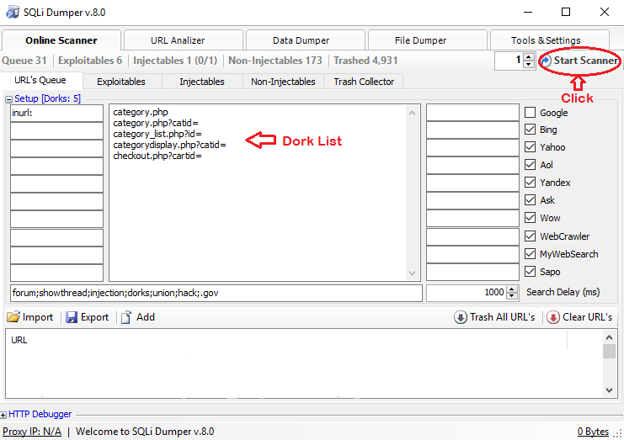
`

Slide 17
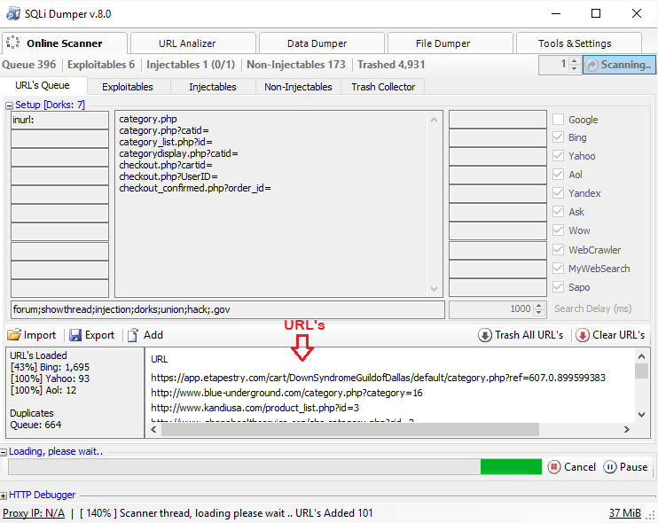

Slide 18
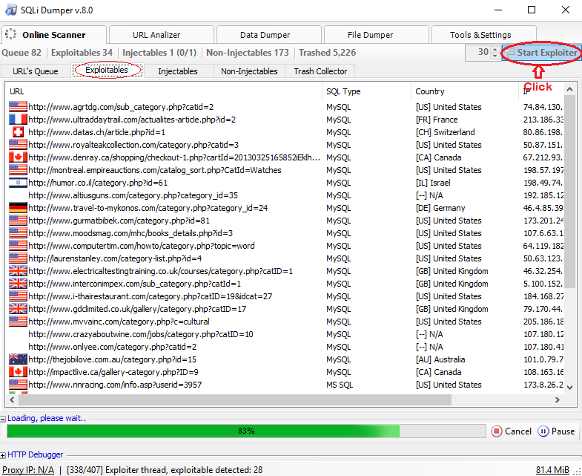

Slide 19
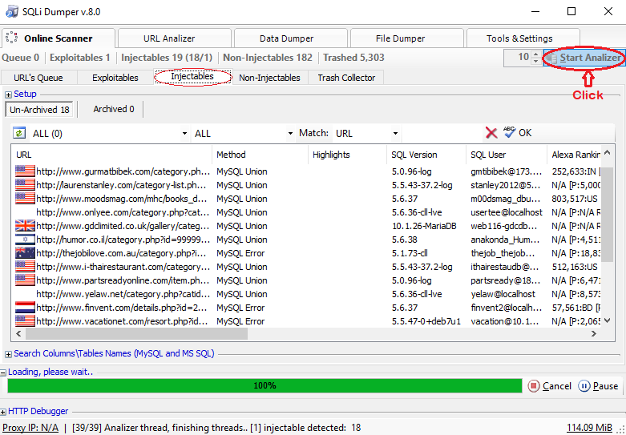

Slide 20
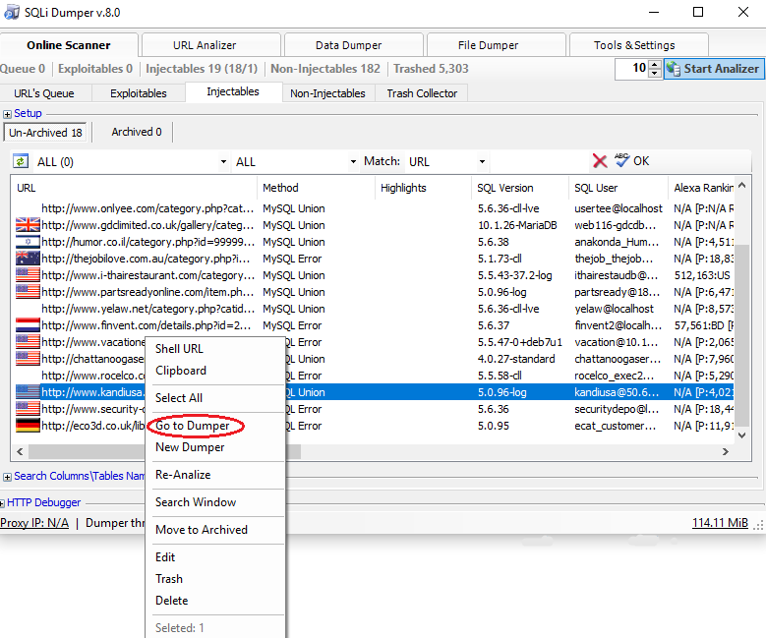

Slide 21
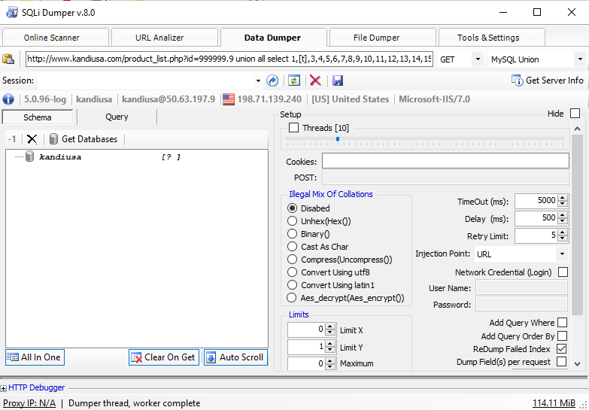

Slide 22
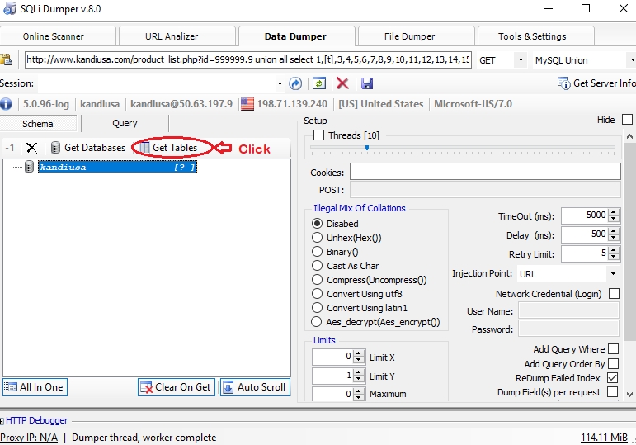

Slide 23
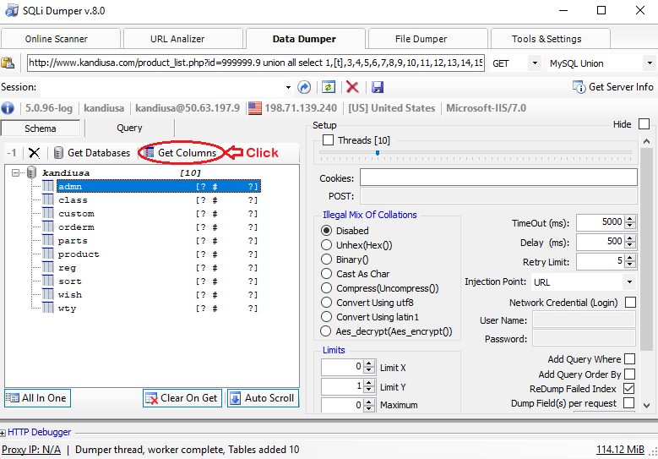

Slide 24
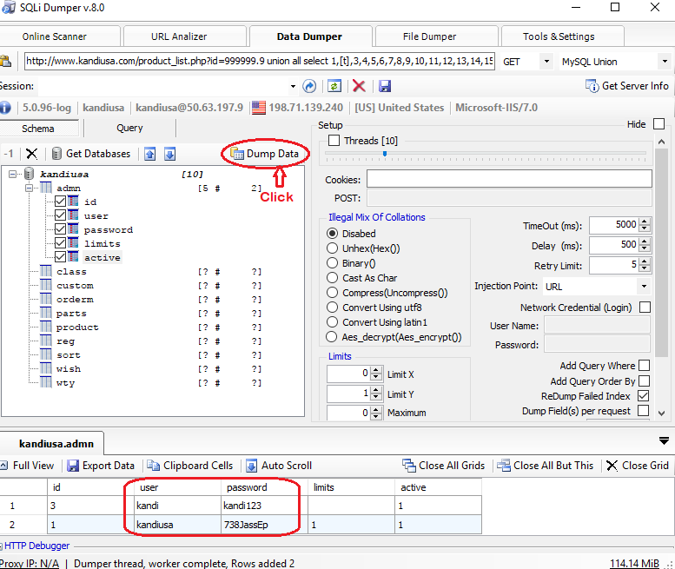

Slide 25
CONCLUSION
Automatic SQL injection tool used mainly to Retrieve Database login names and password hashes with the use of a user friendly GUI.
More efficient and better than other exploitation tools.
Supports almost all databases.
Can dump large amounts of data, with great control of delay each request.

Slide 26
Reference
https://www.cybrary.it/0p3n/pentesting-sqli-dumper-v8-tool/
http://www.softwaretestinghelp.com/penetration-testing-tools/
https://www.scribd.com/document/39022811/Simple-Sqli-Dumper
http://anonangelteam.blogspot.in/2015/04/how-to-use-sqli-dumper-v80-powerful.html

